Slide 1
Security Testing
INFO6255 - Software Quality Contrl & Mgmt
Fall 2019
Medi Servattalab
M.Servattalab@northeastern.edu

Slide 2

What is Security Testing?
Security Testing is defined as a type of Software Testing that ensures software systems and applications are free from any
Vulnerabilities
Threats
Risks
that may cause a big loss.
Security testing of any system is about finding all possible loopholes and weaknesses of the system which might result into
Loss of information
Loss of revenue
Security testing – Guru99.com

Slide 3

Security Testing Goals
To identify the threats in the system and measure its potential vulnerabilities, so the system does not stop functioning or is exploited.
It also helps in detecting all possible security risks in the system and help developers in fixing these problems through coding.

Slide 4


It’s a nasty world out there!!!
Security testing is the most important testing for an application and checks whether confidential data stays confidential.
In this type of testing, tester plays a role of the attacker and plays around the system to find security-related bugs.
Security Testing is very important in Software Engineering to protect data by all means.

Slide 5
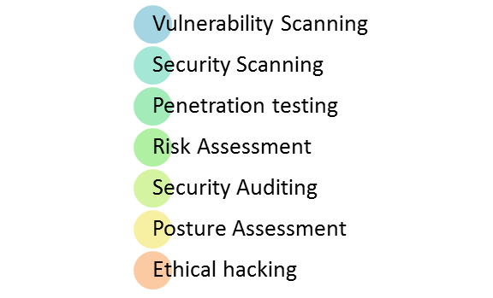

Security Testing Types

Slide 6
Security Testing Definitions
1. Vulnerability Scanning
This is done through automated software to scan a system against known vulnerability signatures.
2. Security Scanning
It involves identifying network and system weaknesses, and later provides solutions for reducing these risks. This scanning can be performed for both Manual and Automated scanning.
3. Penetration testing
This kind of testing simulates an attack from a malicious hacker. This testing involves analysis of a particular system to check for potential vulnerabilities to an external hacking attempt.
Guru99.com

Slide 7
Security Testing Definitions
4. Risk Assessment
This testing involves analysis of security risks observed in the organization. Risks are classified as Low, Medium and High.
5. Security Auditing
This is an internal inspection of Applications and Operating systems for security flaws. Audit can also be done via line by line inspection of code

Slide 8
Security Testing Definitions
6. Ethical hacking
It's hacking an Organization Software systems. Unlike malicious hackers, who steal for their own gains, the intent is to expose security flaws in the system.
7. Posture Assessment
This combines Security scanning, Ethical Hacking and Risk Assessments to show an overall security posture of an organization

Slide 9
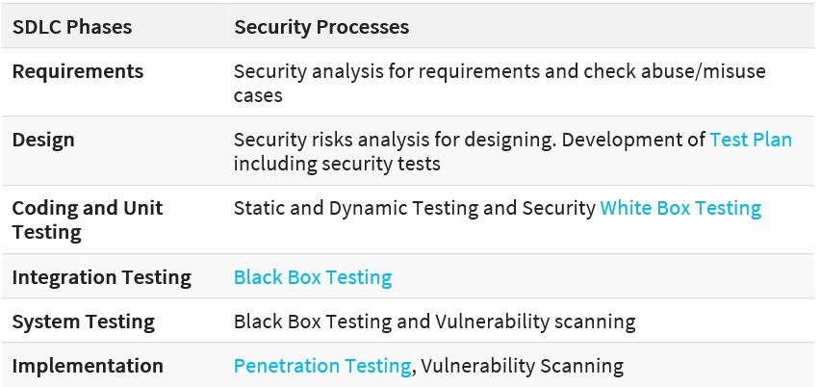
When to do Security Testing
Involve Security Testing in the SDLC in the earlier phases
Guru99

Slide 10
Security Testing Roles
Hackers - Access computer system or network without authorization.
Crackers - Break into the systems to steal or destroy data.
Ethical Hacker - Performs most of the breaking activities but with permission from the owner.
Script Kiddies or packet monkeys - Inexperienced Hackers with programming language skill.

Slide 11
Techniques for Security Testing (Methodologies)
Tiger Box: This hacking is usually done on a laptop which has a collection of Operating Systems and hacking tools.
This testing helps penetration testers and security testers to conduct vulnerabilities assessment and attacks.
Black Box: Tester is authorized to do testing on everything about the network topology and the technology.
Grey Box: Partial information is given to the tester about the system, and it is a hybrid of white and black box models.

Slide 12
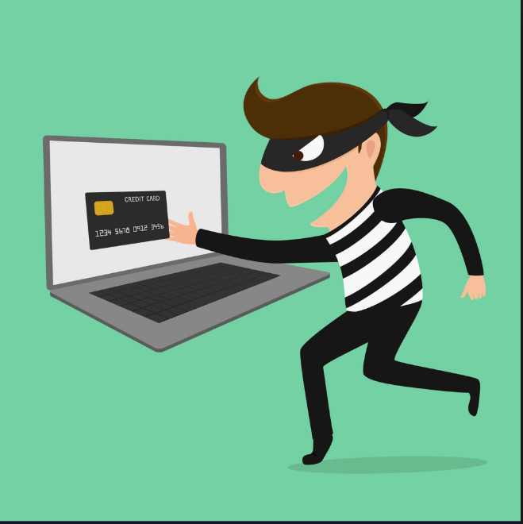
Sample Security Testing Test Scenarios
A password should be in encrypted format.
Application or System should not allow invalid users.
Check cookies and session time for application.
For financial sites, the Browser back button should not work.
A Student Management System is insecure if ‘Admission’ branch can edit the data of ‘Exam’ branch – User Roles.
An ERP system is not secure if DEO (data entry operator) can generate ‘Reports’ – User Roles.
An online Shopping Mall has no security if the customer’s Credit Card Detail is not encrypted.
A custom software possess inadequate security if an SQL query retrieves actual passwords of its users.
Guru99.com and SoftwareTestingHelp.com

Slide 13
Examples of Security Flaws in an Application
8 Top Security Testing Techniques
Access to Application – Roles and Rights Management.
Data Protection – The user can only view the data that he/she is entitled to.
Brute-Force Attack – Software attempts to guess passwords and tries to login again & again.
SQL Injection and XSS (cross-site scripting) – Malicious script is used by hackers in order to manipulate a web site.
Service Access Points (Sealed and Secure Open) – Application to Application Access points should be protected and sealed.
Softwaretestinghelp.com

Slide 14
Examples of Security Flaws in an Application
Session Management – Test for
Session expiry after particular idle time
Session termination after maximum lifetime
Session termination after log out
Check for session cookie scope and duration
Testing if a single user can have multiple simultaneous sessions, etc.
Error handling – Test these by making certain requests to the page such that these error codes are returned
408 request time-out
400 bad requests
404 not found, etc..
Specific Risky functionalities - two risky functionalities are
Payments
File uploads – Test for any unwanted malicious file upload is restricted
These functionalities should be tested very well.
Softwaretestinghelp.com

Slide 15
Security Testing References
https://www.guru99.com/what-is-security-testing.html
https://insights.sei.cmu.edu/sei_blog/2018/07/10-types-of-application-security-testing-tools-when-and-how-to-use-them.html
https://www.tutorialspoint.com/software_testing_dictionary/security_testing.htm
https://www.softwaretestinghelp.com/how-to-test-application-security-web-and-desktop-application-security-testing-techniques/

Slide 16
CyberSecurity
INFO6255 Software Quality Contrl & Mgmt
Fall 2019
Medi Servattalab
M.Servattalab@northeastern.edu

Slide 17
Cybersecurity
Cybersecurity refers to a set of techniques used to protect the integrity of networks, programs and data from attack, damage or unauthorized access.
According to Forbes, the global cybersecurity market is expected to reach 170 billion by 2020.
The rapid market growth BYOD, IoT, The Cloud Based applications and Workloads.

Slide 18
Cybersecurity Vs. Application Security
Software Application Security refers to the prevention of writing vulnerable code and to create processes for secure development.
Cybersecurity is to protect more than just the software application. It refers to the entire infrastructure of a company:
Hardware
Network Switches
Wireless Devices
Firewalls
Databases

Slide 19

Cybersecurity
Protecting Information and systems from Major cyberattacks:
Application attacks
malware
ransomware
phishing
exploit kits
Keeping pace with the sophisticated attacks has been becoming more challenging.
Cyberthreats are now taking aim at: political, military, governments, infrastructures of nations.

Slide 20

Cybersecurity glossary
Botnet Multiple computers on a network that are infected with a program that can be controlled remotely. The infected computers are usually used to cause damage that couldn’t be achieved with a single computer.
DDoS A distributed denial of service attack attempts to make an online service, like a website, unavailable by overwhelming it with a flood of traffic from a team of computers.
Spam Unsolicited emails sent to many addresses. The purpose of most spam is to make money through advertising or identity theft.

Slide 21
Cybersecurity glossary
Hacktivist Someone who uses computers and computer networks to disrupt services or share secret information in an effort to draw attention to political or social issues.
Keylogger malware A program that records every key struck on a keyboard and sends that information to an attacker.

Slide 22

Cybersecurity glossary
Malware Software that harms computers, networks, or people. Includes viruses, worms, ransomware, and other computer programs.
Phishing Attempting to trick people into revealing sensitive information, such as passwords and credit card numbers, often by using emails or fake websites that look like they are from trusted organizations.
Ransomware A type of malware that holds victims’ computer files hostage by locking access to them or encrypting them. It then demands a ransom if the victim wants his or her files back.

Slide 23
Cybersecurity Facts
Last year, Ginni Rometty, IBM’s chairman, president and CEO, said: “Cybercrime is the greatest threat to every company in the world.” And she was right.
During the next five years, cybercrime might become the greatest threat to every person, place and thing in the world.
The average cost of a data breach in 2020 will exceed $150 million
As more business infrastructure gets connected, Juniper Research data suggests that cybercrime will cost businesses over $2 trillion total in 2019
Since 2013 there are 3,809,448 records stolen from breaches every day
158,727 per hour, 2,645 per minute and 44 every second of every day reports Cybersecurity Ventures.
https://www.cybintsolutions.com/cyber-security-facts-stats/

Slide 24
Cybersecurity Facts
Over 75% of healthcare industry has been infected with malware over last year
The study examined 700 healthcare organizations including medical treatment facilities, health insurance agencies and healthcare manufacturing companies.
Large-scale DDoS attacks increase in size by 500%
According to the Q2 2018 Threat Report, Nexusguard’s quarterly report, the average distributed denial-of-service (DDoS) attack grew to more than 26Gbps, increasing in size by 500%.
Approximately $6 trillion is expected to be spent globally on cybersecurity by 2021
Organizations need to make a fundamental change in their approach to cybersecurity and reprioritize budgets to align with this newly defined reality of our modern society.
Unfilled cybersecurity jobs worldwide will reach $3.5 million by 2021
More than 300,000 cybersecurity jobs in the U.S. are unfilled, and postings are up 74% over the past five years.
https://www.cybintsolutions.com/cyber-security-facts-stats/

Slide 25
Facts about Cybersecurity
95% of breached records came from only three industries in 2016
Government, retail, and technology
Why? Because of popularity, high traffic with personal information
There is a hacker attack every 39 seconds
From the Univ of Maryland: affecting one in three Americans every year —and the non-secure usernames and passwords we use that give attackers more chance of success
43% of cyber attacks target small business
64% of companies have experienced web-based attacks.
62% experienced phishing & social engineering attacks
59% of companies experienced malicious code and botnets
51% experienced denial of service attacks
https://www.cybintsolutions.com/cyber-security-facts-stats/

Slide 26
Cybersecurity Facts
By 2020 there will be roughly 200 billion connected devices
The risk is real with IoT and it is growing. According to figures compiled within a recent Symantec Internet Security Threat Report, there are 25 connected devices per 100 inhabitants in the US.
95% of cybersecurity breaches are due to human error
Cyber-criminals and hackers will infiltrate your company through your weakest link, which is almost never in the IT department.
Only 38% of global organizations claim they are prepared to handle a sophisticated cyber attack
What’s worse? An estimated 54 percent of companies say they have experienced one or more attacks in the last 12 months.
https://www.cybintsolutions.com/cyber-security-facts-stats/

Slide 27
Cybersecurity Facts
Total cost for cybercrime committed globally has added up to over $1 trillion dollars in 2018
Don’t think that all that money comes from hackers targeting corporations, banks or wealthy celebrities.
Individual users like you and me are also targets.
As long as you’re connected to the Internet, you can become a victim of cyber attacks.

Slide 28
The Dark Web (Hidden Network of Websites)
Internet: when you visit a website on the WWW, IP addresses trace online activity on your computer.
Dark Web: with the masking software activated, a computer takes a randomized path to its file destination, bouncing around a number of encrypted connections to ultimately mask both location and identity.
In 2017, Experian found the going rates for some dark web sites:
Social Security number: $1
General login: $1
Credit card number with CV: $5
Debit card number with bank info: $15
Driver’s license: $20
https://www.makechange.aspiration.com
https://www.experian.com

Slide 29
The Dark Web - Continued
The Dark Web, a seemingly hidden world a far-cry from the internet we know, love and have become accustomed too.
A place shrouded in mystery for some and wonder for others.
All the criminal activity that takes place. The user is able to surf the internet anonymously.
This means hackers, governments, and even internet service providers and the websites you’re visiting won’t be able to tell who you are.
Explore 8 of the best Dark/Deep Web browsers available right now

Slide 30
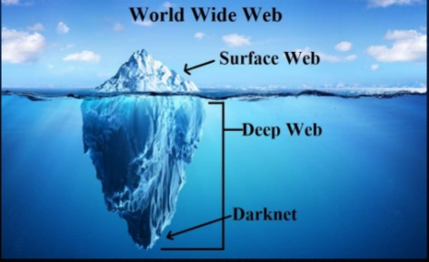
https://towardsthefinalhour.com/2018/10/dark-net-australia-october-2018/

Slide 31
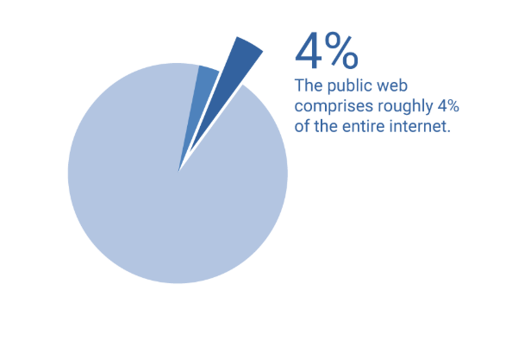
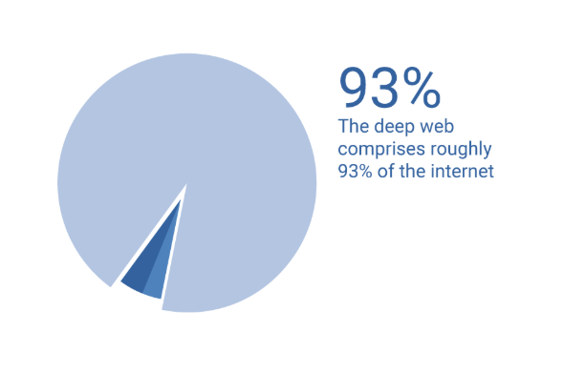
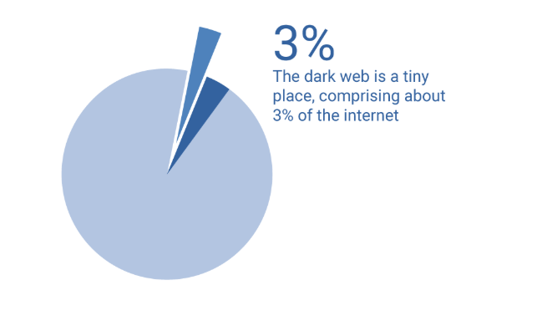
What are the Web Types?
Public Web: Information you normally find on the search engines.
Deep Web: Information that is not indexed by the search engines and does not require Authentication (School, Internal company sites).
Dark Web: Information that is not accessible by normal internet browsers.
https://www.experian.com

Slide 32
8 Best Dark / Deep Web Browsers in 2019
The Tor Browser
Subgraph OS
Firefox
Waterfox
ISP - Invisible Internet Project
Tails - The Amnesic Incognito Live System
Opera
Whonix
https://drfone.wondershare.com/dark-web/dark-web-browser.html

Slide 33
How Can You Protect Yourself from the Dark Web?
Monitor
Monitor your accounts and statements for any information that looks off
Check
Check your credit report regularly to see if inquiries or new accounts appear that you don't recognize
Use
Use strong passwords, and change them often
Consider
Consider an online product to help you protect your identity and monitor your credit.
Know
Know how to respond immediately to suspicious activity
Use
Use Experian's Free Dark Web Scan to see if your Social Security number, phone number, or email address is on the dark web.

Slide 34
The Cybersecurity video
https://www.khanacademy.org/partner-content/nova/cybersecurity/cyber/v/cybersecurity-101

Slide 35
Cyber Security Certifications
1. CEH: Certified Ethical Hacker
2. CISM: Certified Information Security Manager
3. CompTIA Security+
4. CISSP: Certified Information Systems Security Professional
5. GSEC: GIAC Security Essentials
6. ECSA: EC-Council Certified Security Analyst
7. GPEN: GIAC Penetration Tester
8. SSCP: Systems Security Certified Practitioner
9. CRISC: Certified in Risk and Information System Control
10. CISA: Certified Information Systems Auditor
https://www.businessnewsdaily.com/10708-information-security-certifications.html#CEH

Slide 36
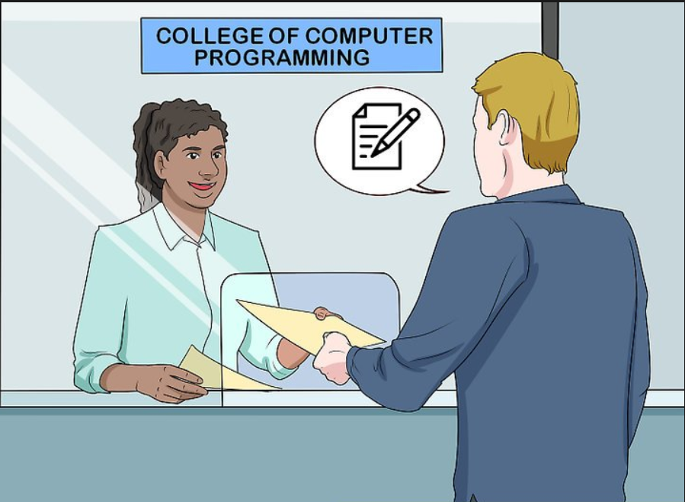
Cyber SECURITY DEGREES & CAREERS
Bachelor’s Degree in Cyber Security
Master’s Degree in Cyber Security
PENETRATION TESTING AND VULNERABILITY ANALYSIS - Introduces methodologies, techniques and tools to analyze and identify vulnerabilities in stand-alone and networked applications.
APPLIED CRYPTOGRAPHY - Examines Modern Cryptography from both a theoretical and applied perspective; emphasis is on provable security and application case studies.
DIGITAL FORENSICS - Instruction in the application of forensic science principles and practices for collecting, preserving, analyzing and presenting digital evidence; covers topics from legal, forensic, and information-technology domains.
https://www.learnhowtobecome.org/computer-careers/cyber-security/

Slide 37
Cyber Security Testing - Courses
INTRODUCTION TO PENETRATION TESTING - Lab-based course providing students with an understanding of the threat vectors and exploitation techniques used to penetrate systems and networks.
Skills Gained:
Assessment
Exploitation
Remediation techniques
FULL SCOPE SECURITY TESTING - Review of the tools, techniques, and sources of digital information and its role in attacking and defending software systems and network environments.
Skills Gained:
Penetration testing processes
Exploitation
ADVANCED MALWARE ANALYSIS - Covers advanced techniques used in malware analysis; focuses heavily on static analysis of unknown binaries utilizing reverse engineering tools and procedures.
Skills Gained:
Anti-debugging processes
x86 assembly language
IDA pro
https://www.learnhowtobecome.org/computer-careers/cyber-security/

Slide 38
CYBER SECURITY JOB GROWTH & OUTLOOK
According to Cisco Systems, Inc., there is a distinct shortage of cyber security professionals, particularly those with data science skills. As a result of this scarcity, many computer science workers, particularly those currently in the IT field, are eyeing employment in cyber security.
Indeed, as job growth goes, it's hard to find a profession that outpaces cyber security. According to the U.S. Bureau of Labor Statistics, for example, job growth from 2012 to 2022 for Information Security Analysts is projected to be 37 percent compared with 18 percent for all computer occupations and 11 percent for all occupations.

Slide 39

So why is job growth in cyber security expected to be so robust?
Cyber crime continues to be a significant and growing problem, both in the United States and around the world.
For example, a record 79 percent of respondents to a recent PricewaterhouseCooper's study reported that they had detected a security incident within the past 12 months.

Slide 40
References
https://www.cybintsolutions.com/cyber-security-facts-stats/
https://www.businessnewsdaily.com/
https://www.khanacademy.org/partner-content/nova/cybersecurity/cyber/e/cybersecurity-101-quiz
https://www.learnhowtobecome.org/computer-careers/cyber-security/

